Slide 1





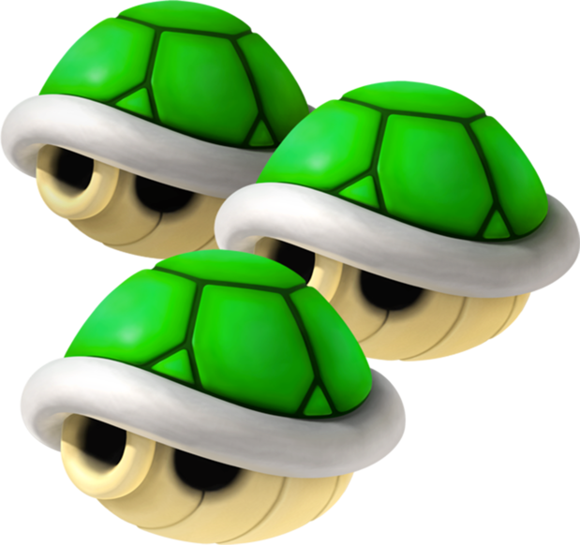
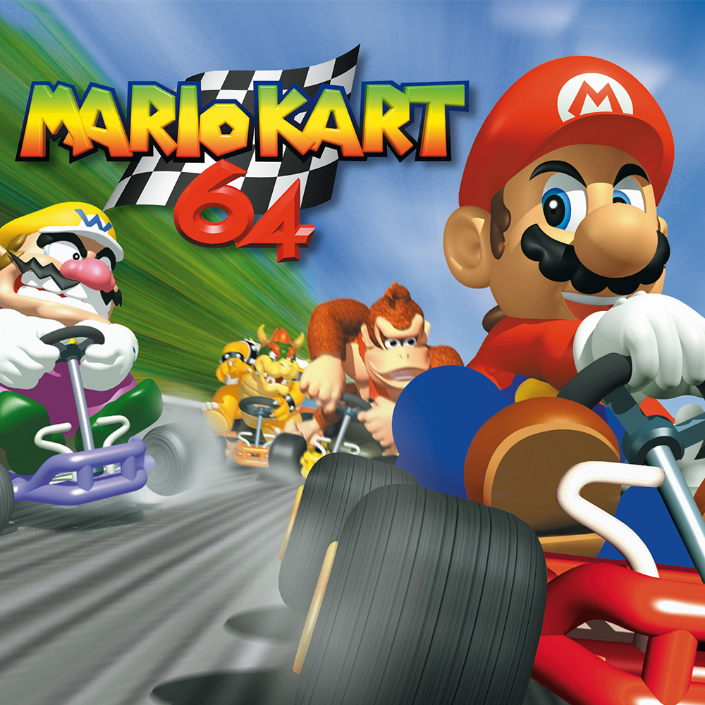
Mario Kart
Self
Drive
Search
Use item
Sequence
Use Search AI to replace imitation learning, saving human efforts.
Remap N64 joystick return byte as steering pobabilities, with drift action together to form 21 pairs of actions. And we reduce to 15 actions.
Record Search Root image and action with best reward.
Include three parts:
1. Item Detection with Tree model
2. Kart Detection with Yolo
3. AI strategy to use different items
The sequential input with 3 prior screenshots to .capture features over time
The output with previous influence.
Introduction
Problem
Statement
• ‘Many research efforts exist in developing autonomous vehicles.’
• ‘Mario Kart 64 represents a simplification of real-life autonomous driving, yet introduces interesting challenges, such as hazards, jumps, and items.’
• We developed a real-time Mario Kart 64 autopilot which trains and plays without human intervention by the BizHawk emulator
How to improve the simplified model with Drift, Use items and Sequence?
Achievements & Conclusion
We develop a self-driving Mario Kart AI with Sequential Input, Drifting and Using Items.
The methods include - Search AI, - Autopilot Model with Sequential Input, Steering & Drift Control, - DT and Yolo for items using.
Possible improvement in the future:
- When stuck on walls, the AI don’t know which direction to go.
- The stability of the merged system
- RL that reward better performance and punish error condition.
- The strategy of using some items.
Deep learning for NLP and CV
2018.12.11
Team
Chen, Junyi
Du, Haikun
Zeng, Jianhuan

